Slide 1

Verification of the Google quantum computer by means of cross entropy
Akshay Durgapersadh

Slide 2
Outline
Why are we interested in quantum computers?
Should quantum computers be trusted?
Basic method of obtaining bitstrings
Haar measure
Cross entropy benchmarking (XEB) Fidelity
Entropy
The weighted PT distribution
Distribution of measurement probabilities
Demonstrating quantum supremacy

Slide 3
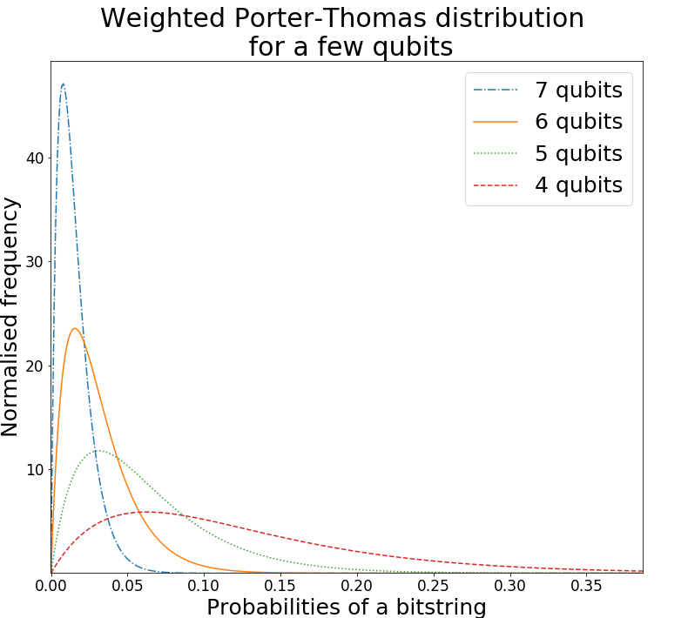
The output of a quantum computer will follow some probability distribution
The ideal output probability distribution is the weighted Porter-Thomas (PT) distribution
The output probability distribution with full error is the uniform distribution.
We want to construct a distance between the full error output distribution and the experimental output distribution

Slide 4
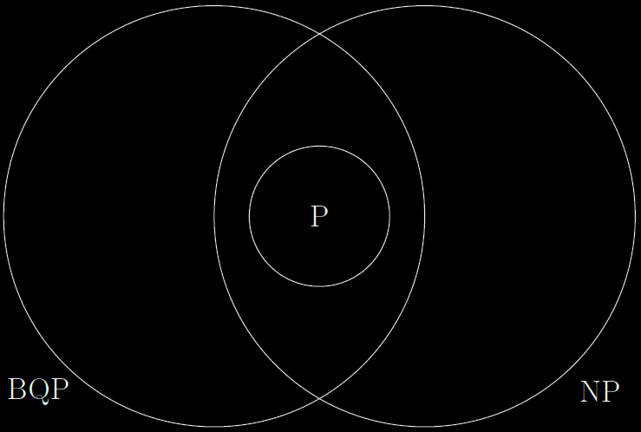
Why are we interested in quantum computers?
Quantum computing has potential applications.
Quantum computing deals with efficiently solving problems in the complexity class BQP.
P is the classical analogy
NP is the class of problems which can be efficiently
verified classically.

Slide 5
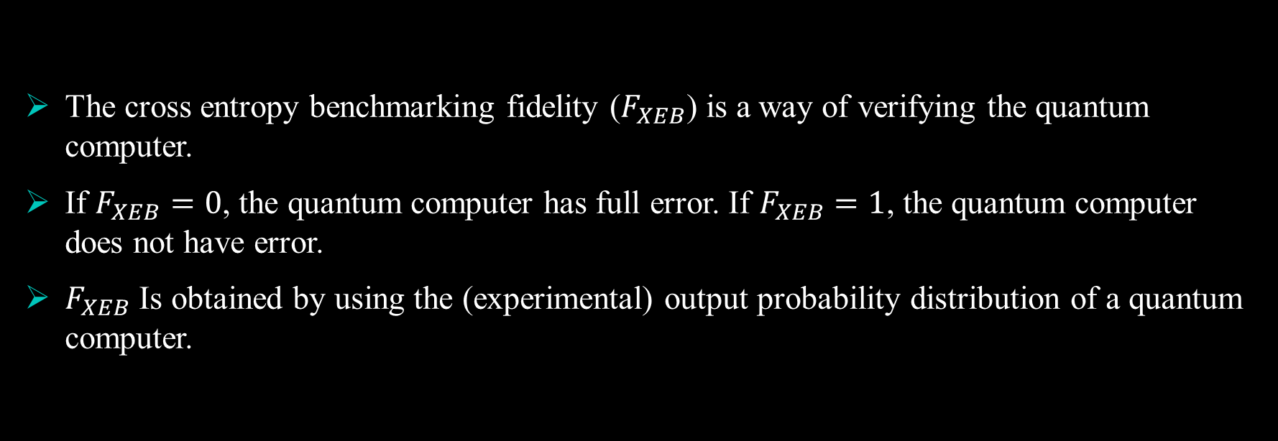
Should quantum computers be trusted?
The cross entropy benchmarking fidelity ($F_{XEB}$) is a way of verifying the quantum computer.
If $F_{XEB}=0$, the quantum computer has full error. If $F_{XEB}=1$, the quantum computer does not have error.
$F_{XEB}$ Is obtained by using the (experimental) output probability distribution of a quantum computer.

Slide 6
Basic method of obtaining bitstrings
Random unitary matrix generated by Haar measure
Quantum computer
State
Measurement
Output bitstring
The above process is repeated a certain number of times for a fixed unitary matrix which
was obtained from Haar measure.
These output bitstrings follow a certain (experimental) probability distribution which will hint at the quality of the quantum computer.

Slide 7
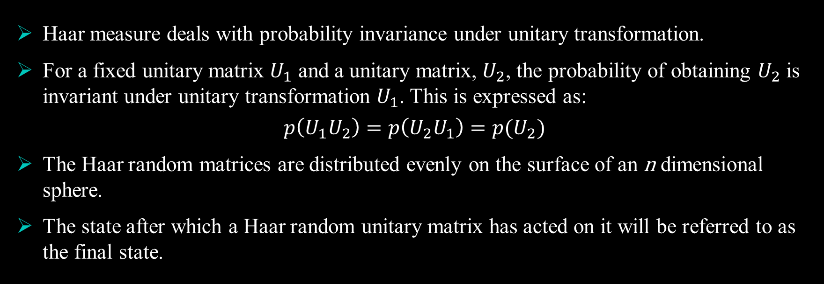
Haar measure
Haar measure deals with probability invariance under unitary transformation.
For a fixed unitary matrix $U_{1}$ and a unitary matrix, $U_{2}$, the probability of obtaining $U_{2}$ is invariant under unitary transformation $U_{1}$. This is expressed as:
$$p\left(U_{1}U_{2}\right)=p\left(U_{2}U_{1}\right)=p(U_{2})$$
The Haar random matrices are distributed evenly on the surface of an n dimensional sphere.
The state after which a Haar random unitary matrix has acted on it will be referred to as the final state.

Slide 8
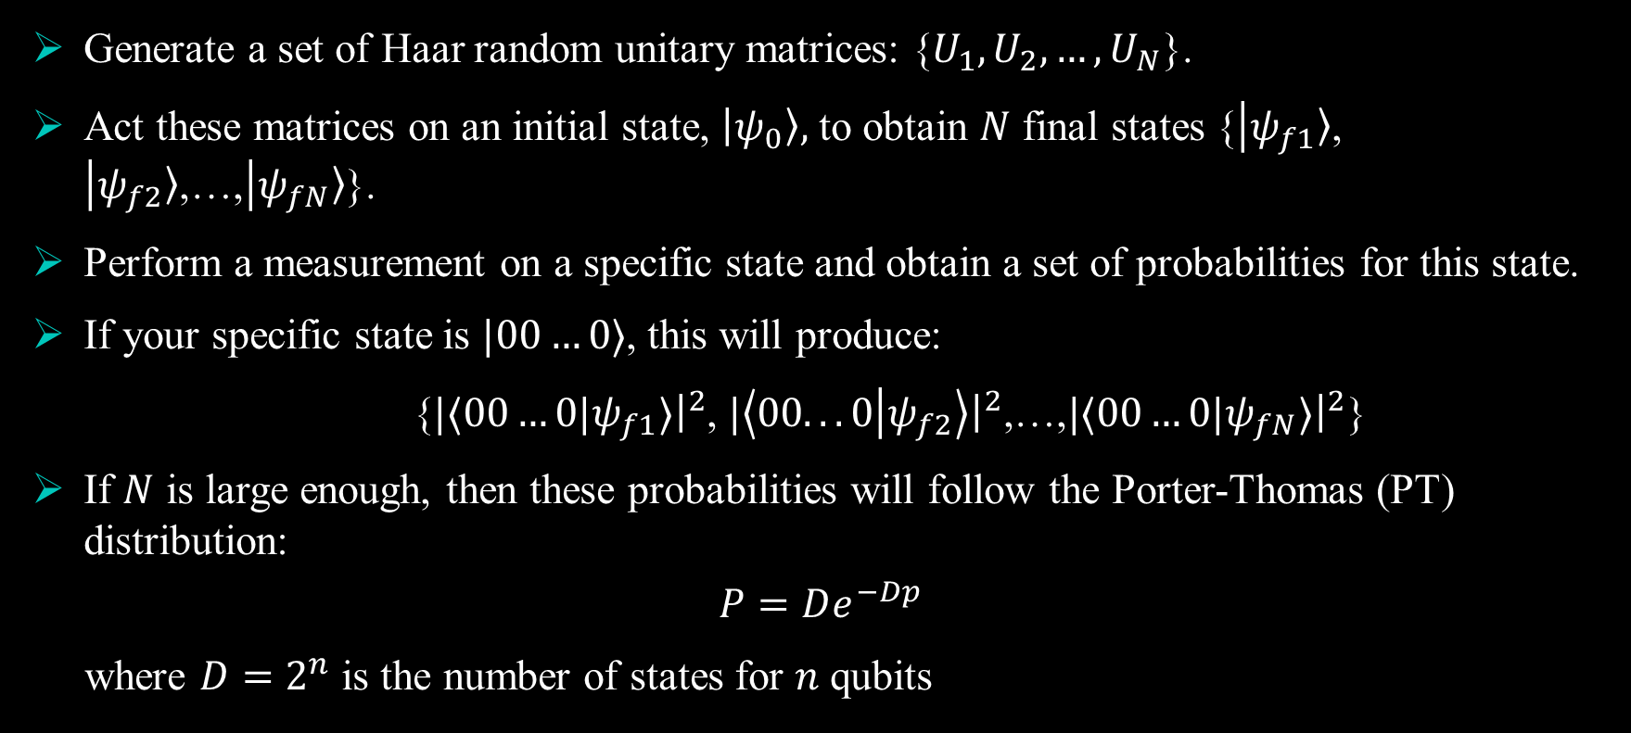
Distribution of measurement probabilities
Generate a set of Haar random unitary matrices: {$U_{1},U_{2}, …,U_{N}$}.
Act these matrices on an initial state, $|ψ_{0}〉,$ to obtain $N$ final states {$|ψ_{f1}〉$, $|ψ_{f2}〉$,…,$|ψ_{fN}〉$}.
Perform a measurement on a specific state and obtain a set of probabilities for this state.
If your specific state is $|00…0⟩$, this will produce:
{$|⟨00…0|ψ_{f1}⟩{\left.​\right|}^{2}$, $|\left\langle 00...0 | ψ_{f2}\right\rangle {\left.​\right|}^{2}\text{,…,}|⟨00…0|ψ_{fN}⟩{\left.​\right|}^{2}$}
If $N$ is large enough, then these probabilities will follow the Porter-Thomas (PT) distribution:
$$P=De^{−Dp}$$
where $D=2^{n}$ is the number of states for $n$ qubits

Slide 9
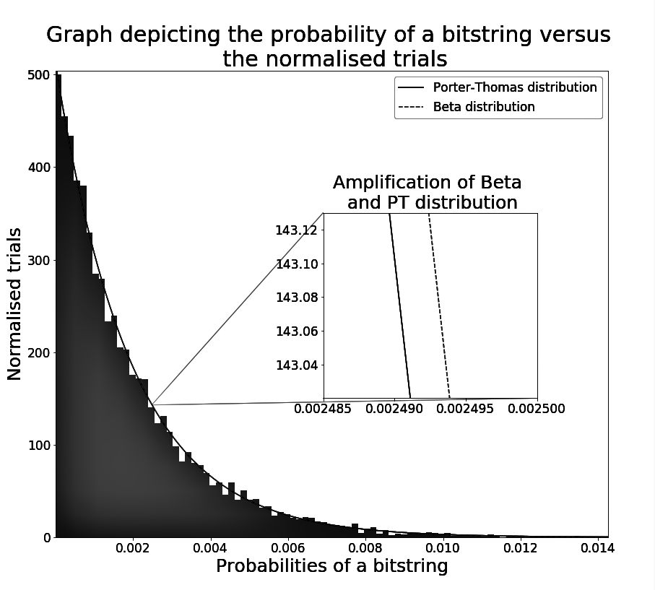
The PT distribution obtained using Haar measure can be seen in the diagram to the right.
The PT distribution shifts towards 0 for an increase in the dimension.
This is a probability distribution of probabilities
The bitstring probabilities from 0-0.006 are most probable to occur

Slide 10
The weighted PT distribution
Quantum computer
State
Bitstring
Measurement
Haar random unitary matrix
Classical computer
Calculate state
Get corresponding bitstring (ideal) probability
This is the basic idea of how to obtain ideal probabilities of bitstrings. Repeat this process many
times with the same unitary matrix for an experimental distribution of these probabilities.

Slide 11
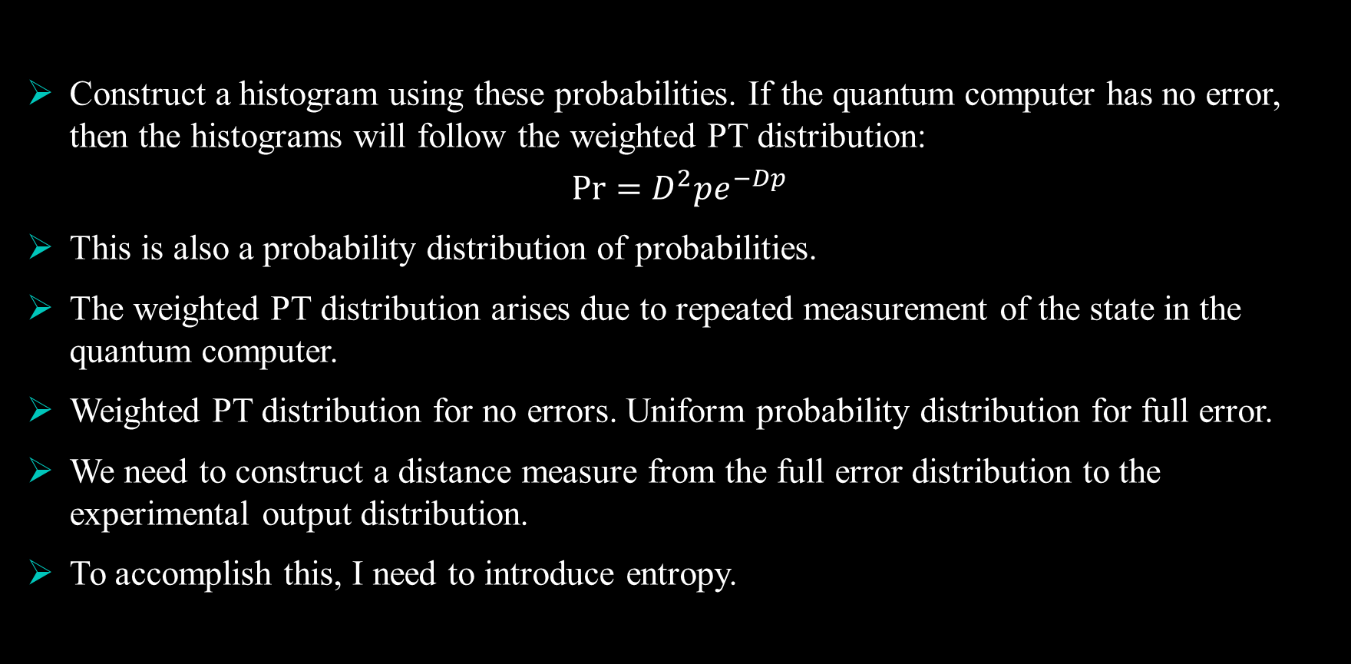
Construct a histogram using these probabilities. If the quantum computer has no error, then the histograms will follow the weighted PT distribution:
$$Pr=D^{2}pe^{−Dp}$$
This is also a probability distribution of probabilities.
The weighted PT distribution arises due to repeated measurement of the state in the quantum computer.
Weighted PT distribution for no errors. Uniform probability distribution for full error.
We need to construct a distance measure from the full error distribution to the experimental output distribution.
To accomplish this, I need to introduce entropy.

Slide 12
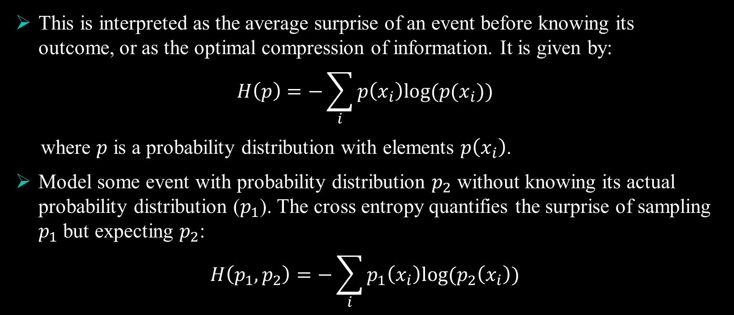
Shannon’s entropy
This is interpreted as the average surprise of an event before knowing its outcome, or as the optimal compression of information. It is given by:
$$H\left(p\right)=−\sum_{i}{p\left(x_{i}\right)log(p(x_{i}))}$$
where $p$ is a probability distribution with elements $p\left(x_{i}\right)$.
Model some event with probability distribution $p_{2}$ without knowing its actual probability distribution ($p_{1}$). The cross entropy quantifies the surprise of sampling $p_{1}$ but expecting $p_{2}$:
$$H\left(p_{1}, p_{2}\right)=−\sum_{i}{p_{1}\left(x_{i}\right)log⁡(p_{2}\left(x_{i}\right))}$$

Slide 13
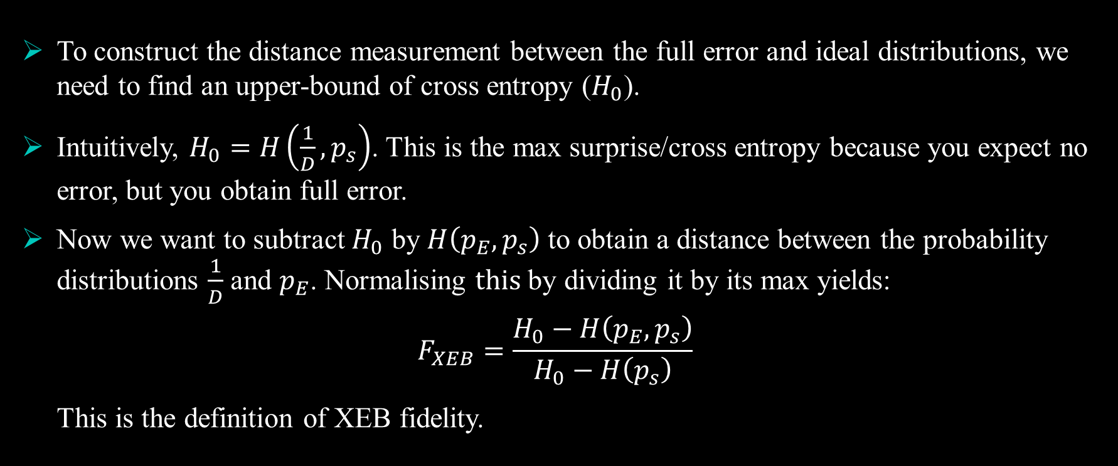
XEB Fidelity
To construct the distance measurement between the full error and ideal distributions, we need to find an upper-bound of cross entropy ($H_{0}$).
Intuitively, $H_{0}=H\left(\frac{1}{D}, p_{s}\right)$. This is the max surprise/cross entropy because you expect no error, but you obtain full error.
Now we want to subtract $H_{0}$ by $H\left(p_{E}, p_{s}\right)$ to obtain a distance between the probability distributions $\frac{1}{D}$ and $p_{E}$. Normalising $this$by dividing it by its max yields:
$$F_{XEB}=\frac{H_{0}−H\left(p_{E}, p_{s}\right)}{H_{0}−H\left(p_{s}\right)}$$
This is the definition of XEB fidelity.

Slide 14
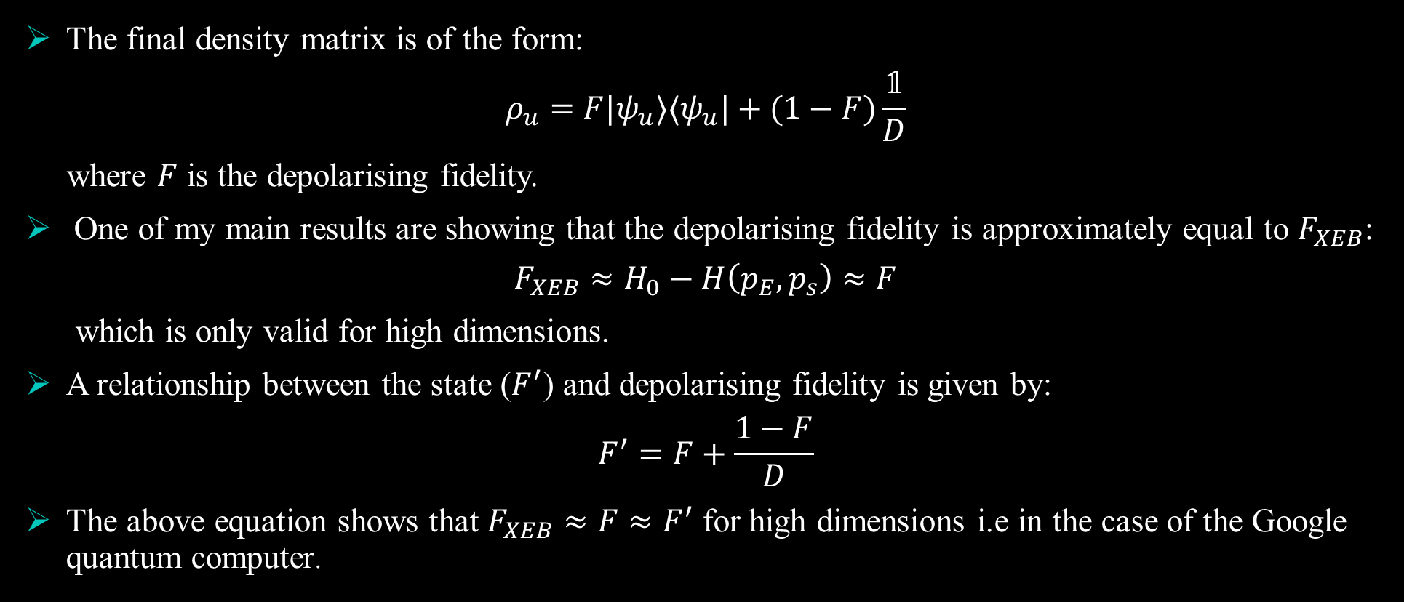
XEB fidelity for high dimensions
The final density matrix is of the form:
$$ρ_{u}=F|ψ_{u}⟩⟨ψ_{u}|+(1−F)\frac{𝟙}{D}$$
where $F$ is the depolarising fidelity.
One of my main results are showing that the depolarising fidelity is approximately equal to $F_{XEB}$:
$$F_{XEB}≈H_{0}−H\left(p_{E}, p_{s}\right)≈F$$
which is only valid for high dimensions.
A relationship between the state ($F^{′}$) and depolarising fidelity is given by:
$$F^{′}=F+\frac{1−F}{D}$$
The above equation shows that ${F_{XEB}≈F≈F}^{′}$ for high dimensions i.e in the case of the Google quantum computer.

Slide 15
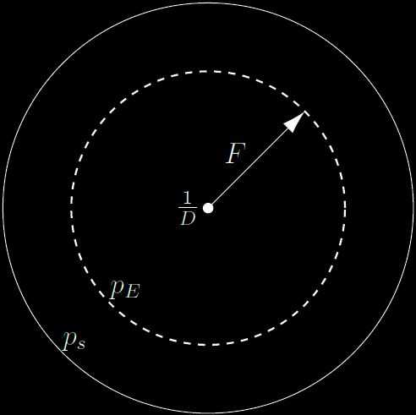
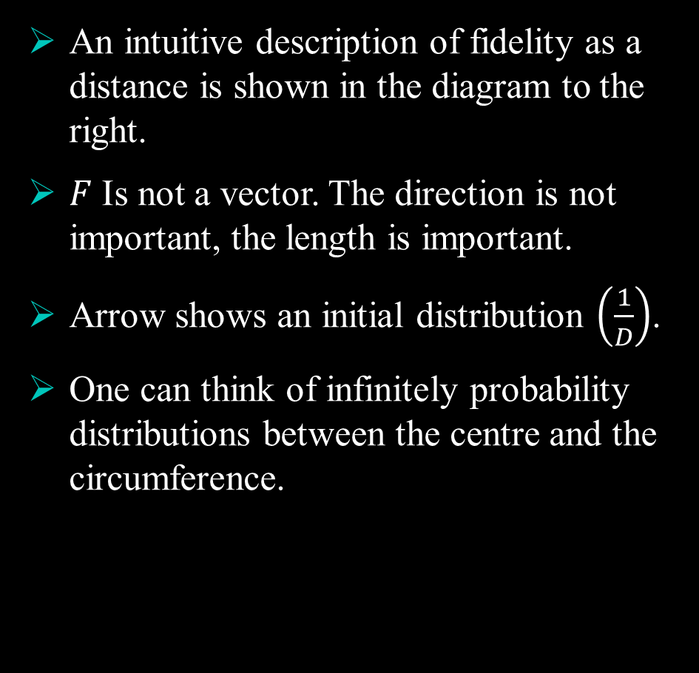
An intuitive description of fidelity as a distance is shown in the diagram to the right.
$F$ Is not a vector. The direction is not important, the length is important.
Arrow shows an initial distribution $\left(\frac{1}{D}\right)$.
One can think of infinitely probability distributions between the centre and the circumference.

Slide 16
Demonstrating quantum supremacy
Two circuits-Classically verifiable and a quantum supremacy circuit.
The quantum supremacy circuit cannot be efficiently verified using a classical computer only. This shows quantum supremacy.
The XEB fidelity is approximated by using the patched/elided circuits.
This shows that the fidelity decreases exponentially for an increase in the number of cycles and qubits

Slide 17
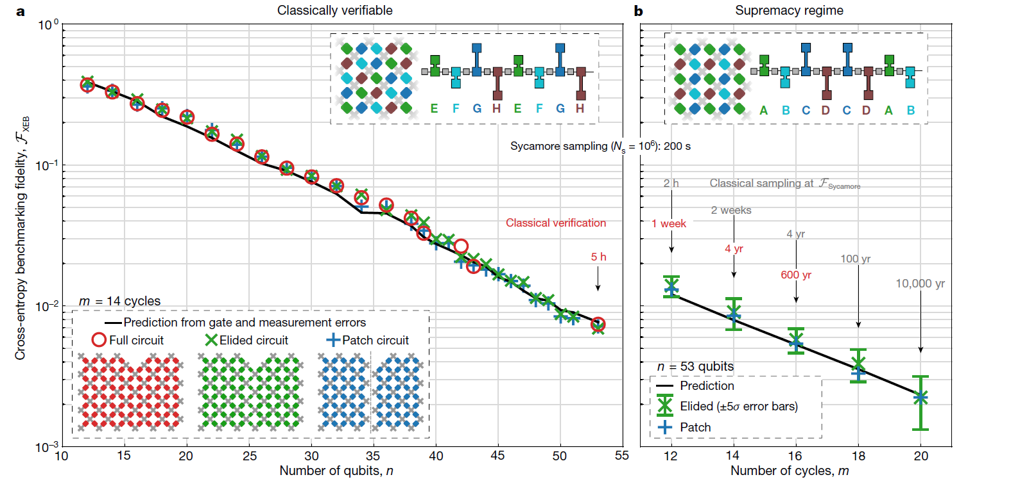

Slide 18
Conclusion
XEB Fidelity together with the patched/elided circuits produce a good method to verify quantum computers for a high number of qubits
Quantum supremacy is shown

Slide 19
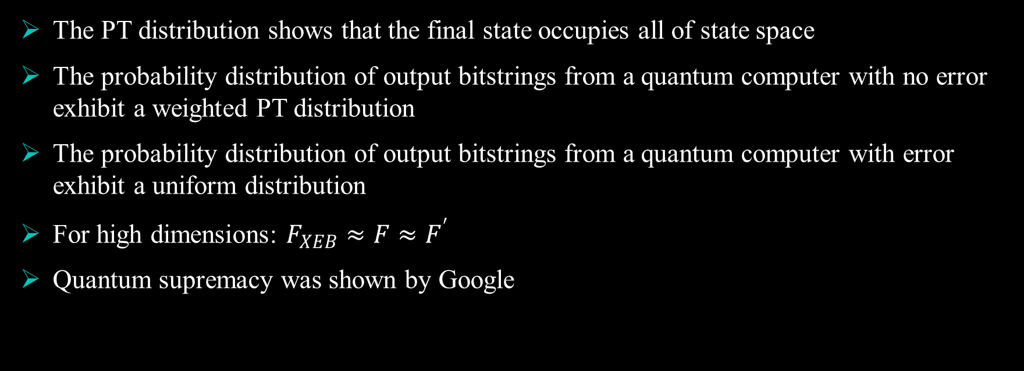
Summary
The PT distribution shows that the final state occupies all of state space
The probability distribution of output bitstrings from a quantum computer with no error exhibit a weighted PT distribution
The probability distribution of output bitstrings from a quantum computer with error exhibit a uniform distribution
For high dimensions: ${F_{XEB}≈F≈F}^{′}$
Quantum supremacy was shown by Google

Slide 20
The end
Thank you for your time

